Slide 1

WELLCOME TO OUR PRESENTATION

Slide 2
DITIAL LIBRARY
Submitted From:
S M Masfequier Rahman(18192103087)
Asraful Islam(18192103070)
Shoheb Nur Asif(18192103082)
Rasel Mahmud(18192103086)
Supervised By:
Aditya Rajbongshi
Lecturer
Department of CSE
BUBT
Team-Vigilante

Slide 3
Content
Introduction
Problem Statement
Our System
Features
Diagrams
Technology
GUI
Authentication
Benefits
Limitation
Conclution

Slide 4
Introduction
1
Let’s start with the first set of slides

Slide 5
INTRODUCTION
Library is the collection of different types of books.
It provides Books for large number of readers
Thus we need software for managing the Library.
Digital Library Software provides the systematic handling the records of books and readers

Slide 6
PROBLEM STATEMENT

Slide 7
PROBLEM STATEMENT
A Good Handle system
A Good data updating.
A Good data updating.
Less Human error.
Easy Communication system.
A Good Data Recording system.

Slide 8
OUR SYSTEM

Slide 9
OUR SYSTEM
Our system is an Online Digital Library website from where people can view and download books quickly and easily without any query.
Admin monitors the activity of the users and checks the status of the website.
Admin can add , edit ,and delete books information with the help of database and a special search feature.

Slide 10
FEATURES

Slide 11
FEATURES
Sign in & Sign up
Search System
Category wise selection
PDF download option
Book issue
Secure Admin panel
Clean UI/UX

Slide 12
Diagram

Slide 13
DIAGRAM
Agile Methodology
System Architecture
Use Case Diagram
Level 2 DFD
ER Diagram

Slide 14
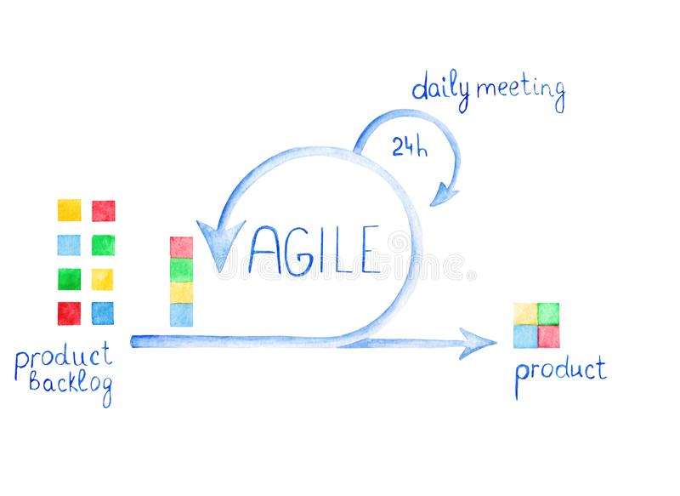
AGILE METHODOLOGY
Fig : Agile Methodology

Slide 15
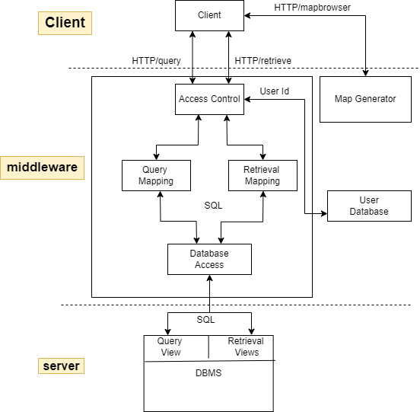
System Architecture
Fig : Digital Library System Architecture

Slide 16
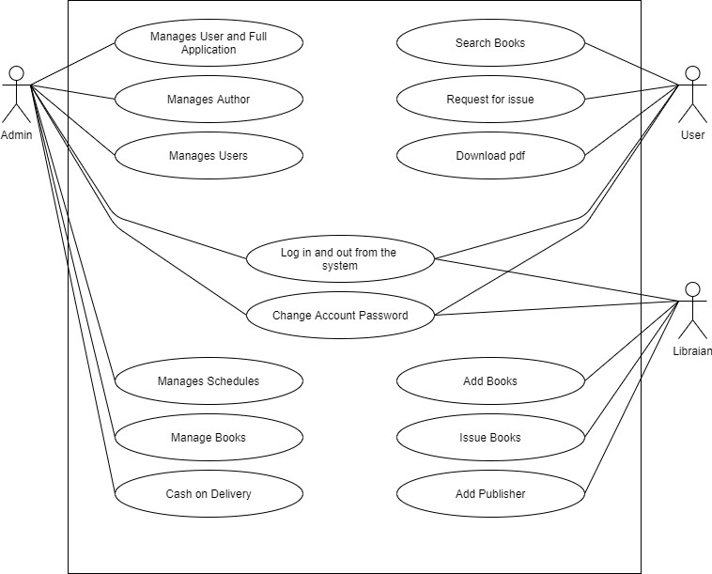
USE CASE DIAGRAM
Fig : Digital Library Use Case Diagram

Slide 17
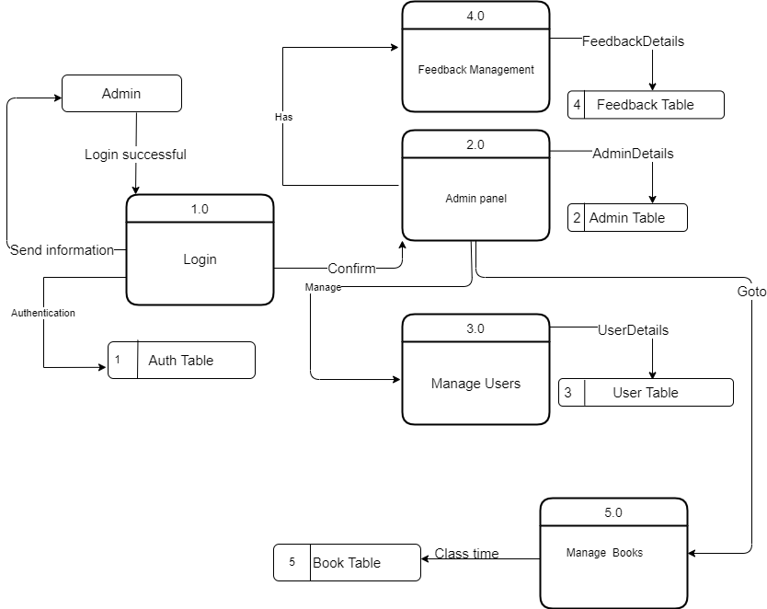
Level 2 Diagram
Fig : Digital Library Level 2 Diagram

Slide 18
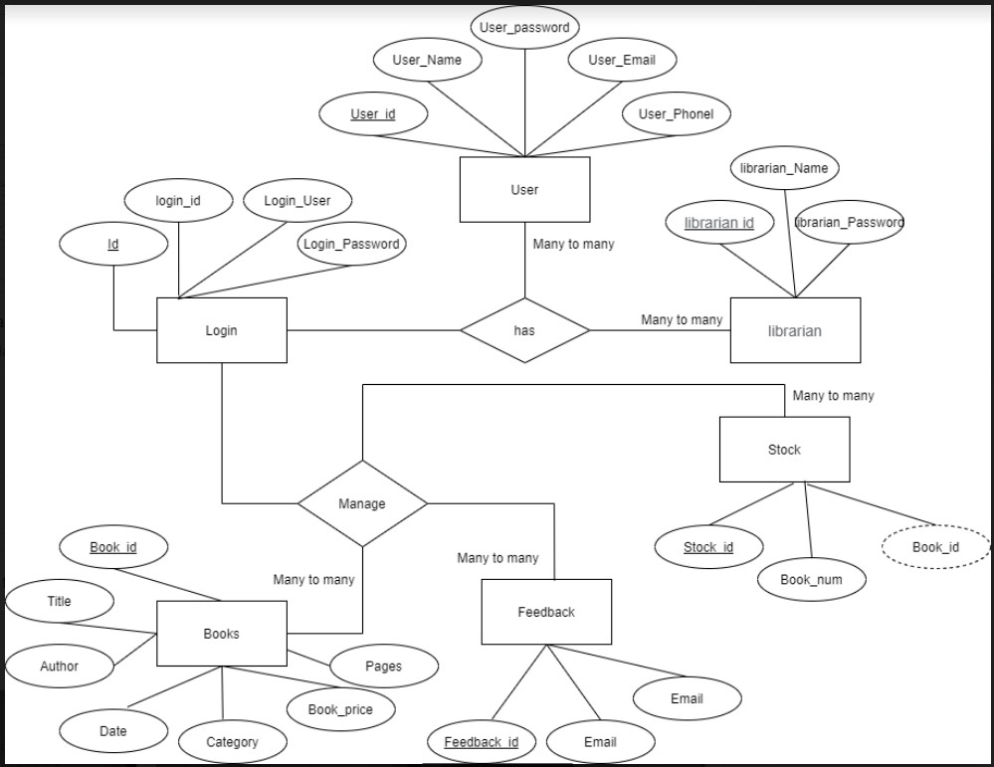
ER DIAGRAM
Fig : Digital Library ER Diagram

Slide 19
TECHNOLOGY

Slide 20
TECHNOLOGY
Languages:
HTML
CSS
SCSS
JAVASCRIPT
Bootstrap
Material UI
REACT
NODE.JS
EXPRESS.JS
MYSQL
Tools:
Visual Studio
Mysql Workbeanch

Slide 21
GUI

Slide 22
GUI(Graphical User Interface)
Home
Books
Category
Details page
Related Books
About Us
Search
Login & sign-up
Dashboard

Slide 23
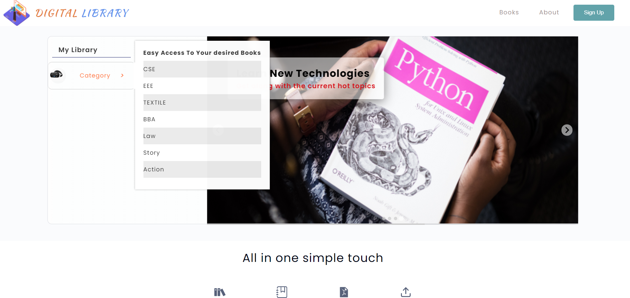
HOME

Slide 24
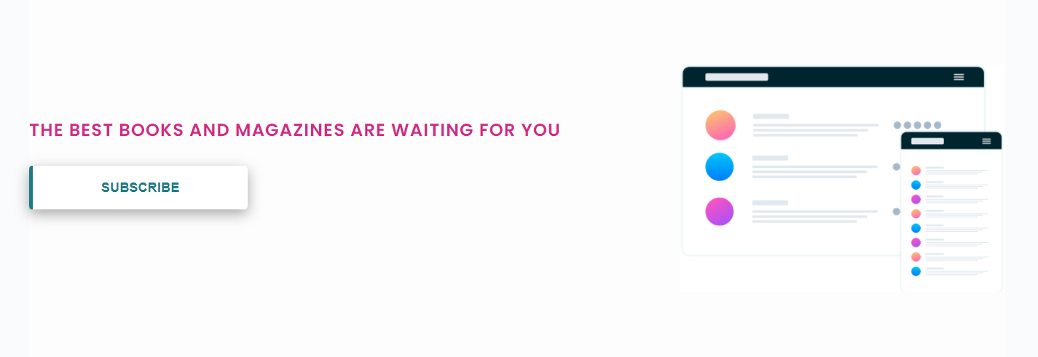
HOME

Slide 25
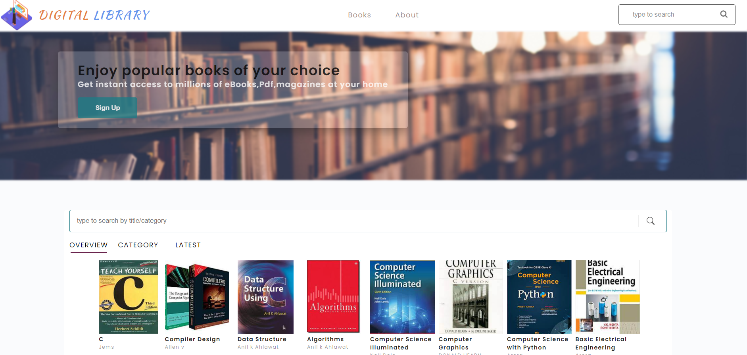
BOOKS

Slide 26
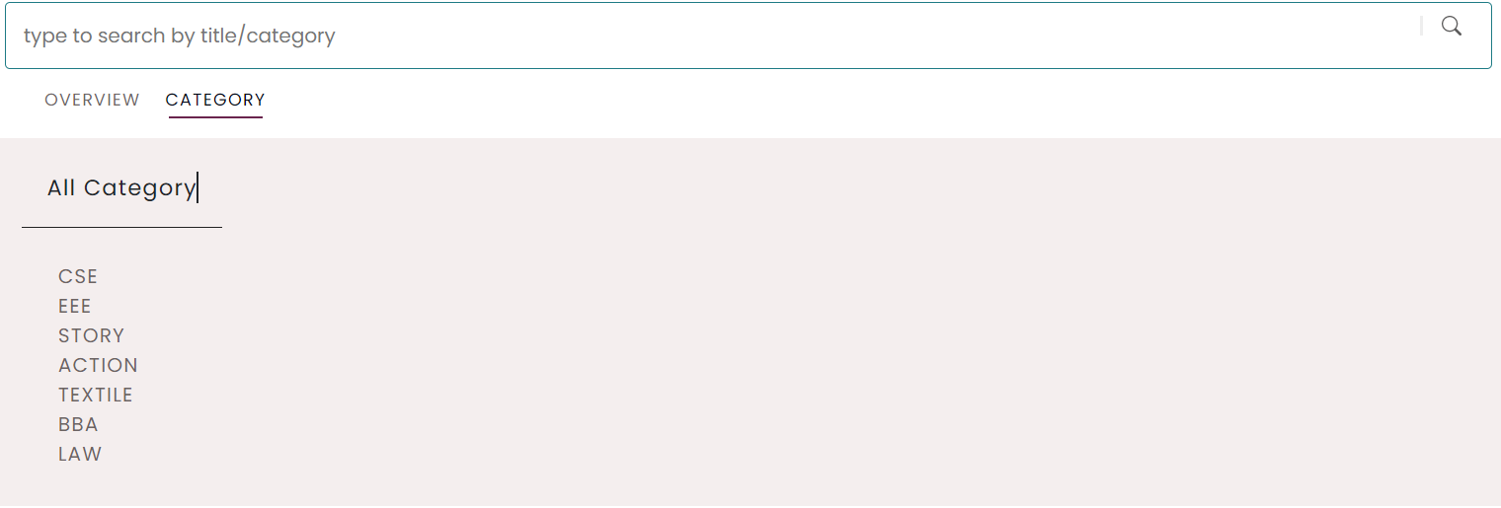
CATEGORY

Slide 27
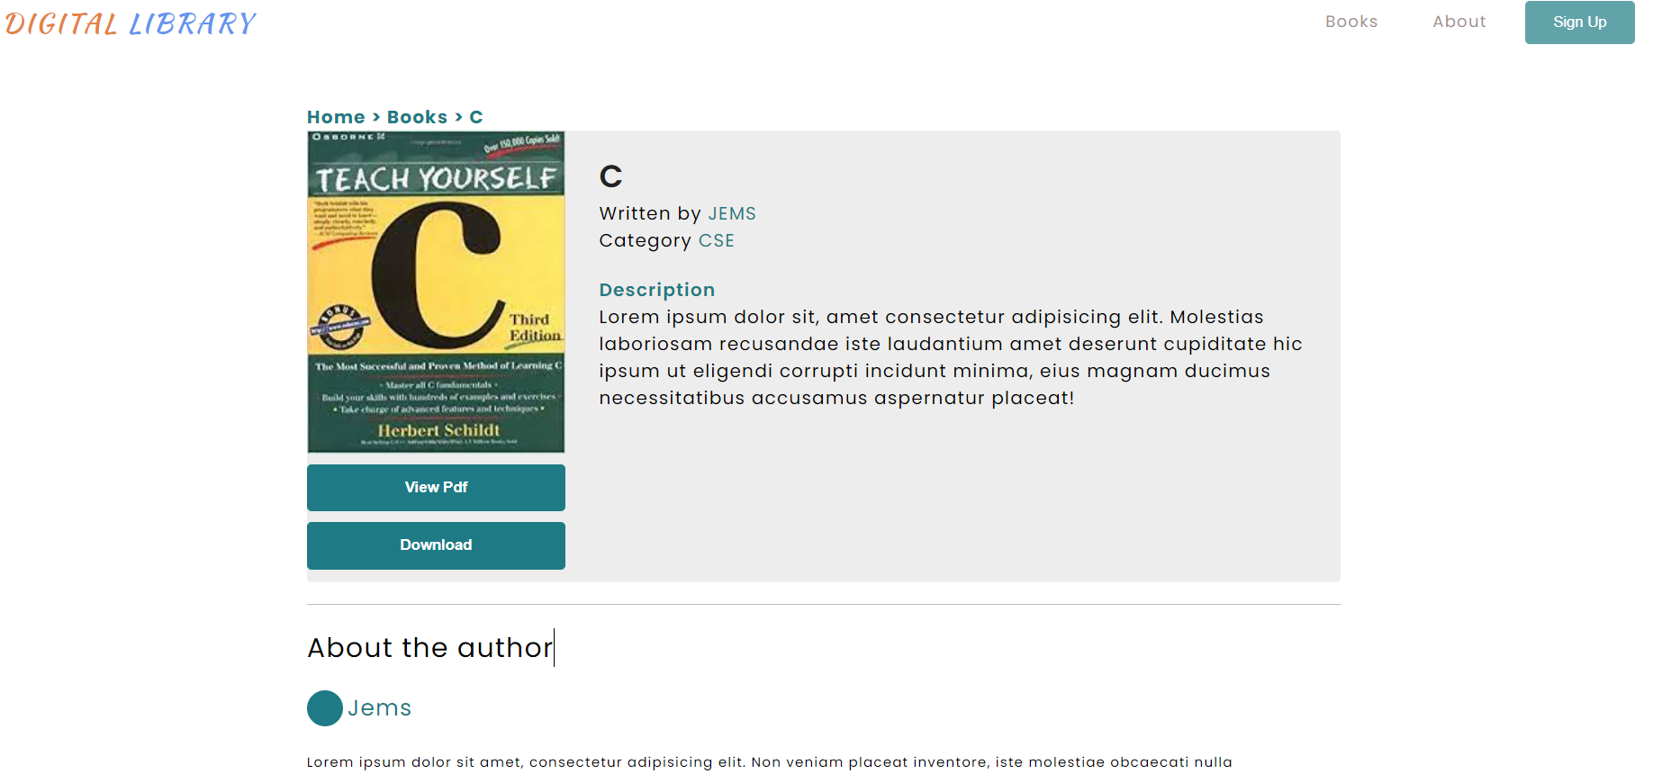
Book Details

Slide 28
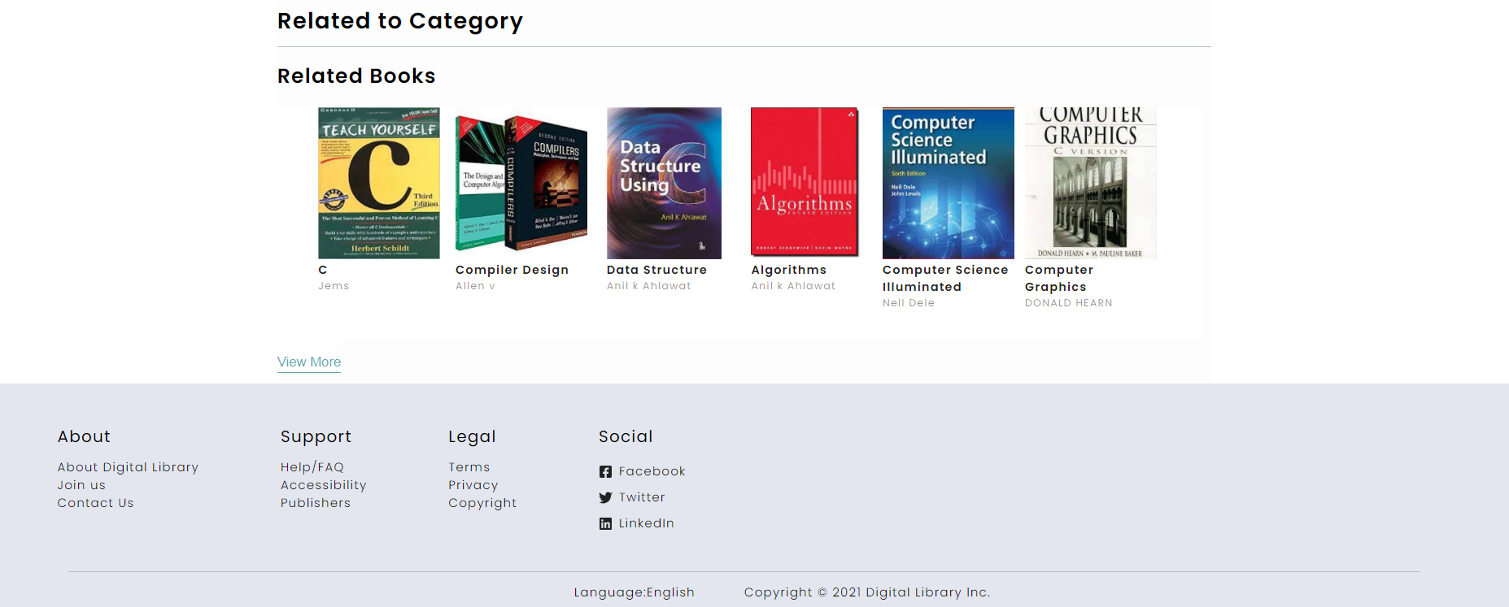
Book Details

Slide 29
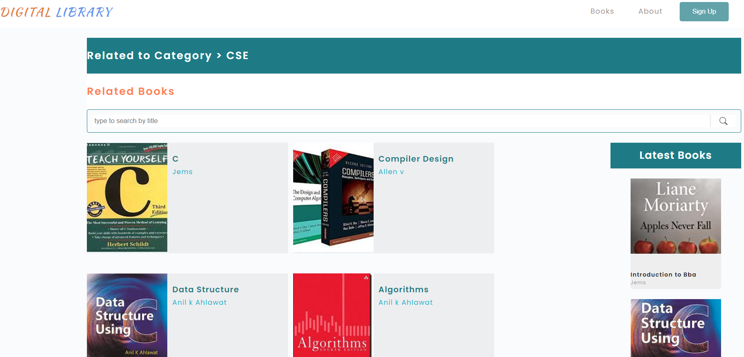
Related Books

Slide 30
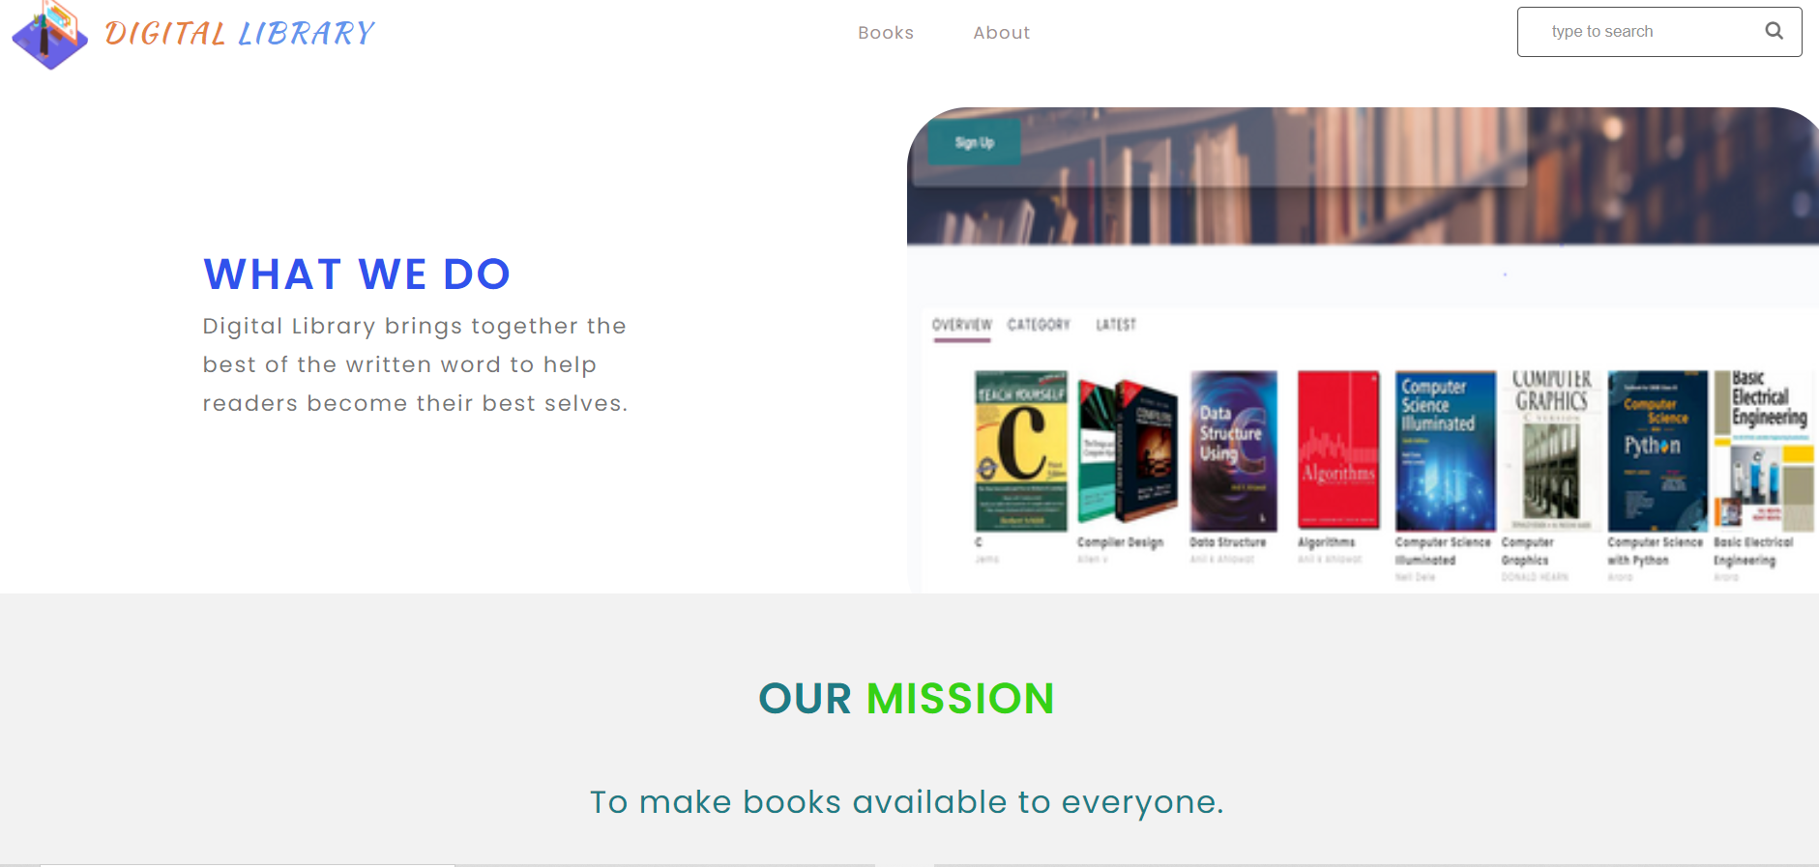
About Us

Slide 31
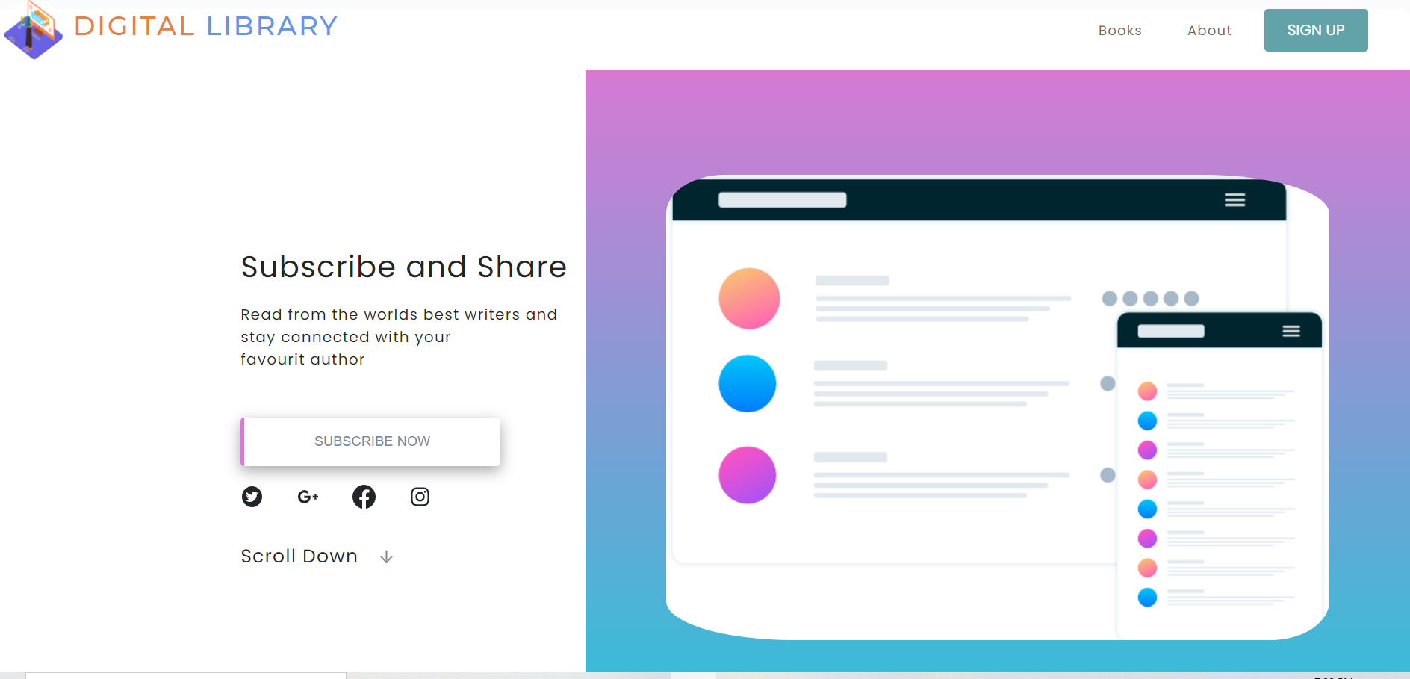
SUBSCRIPTION

Slide 32
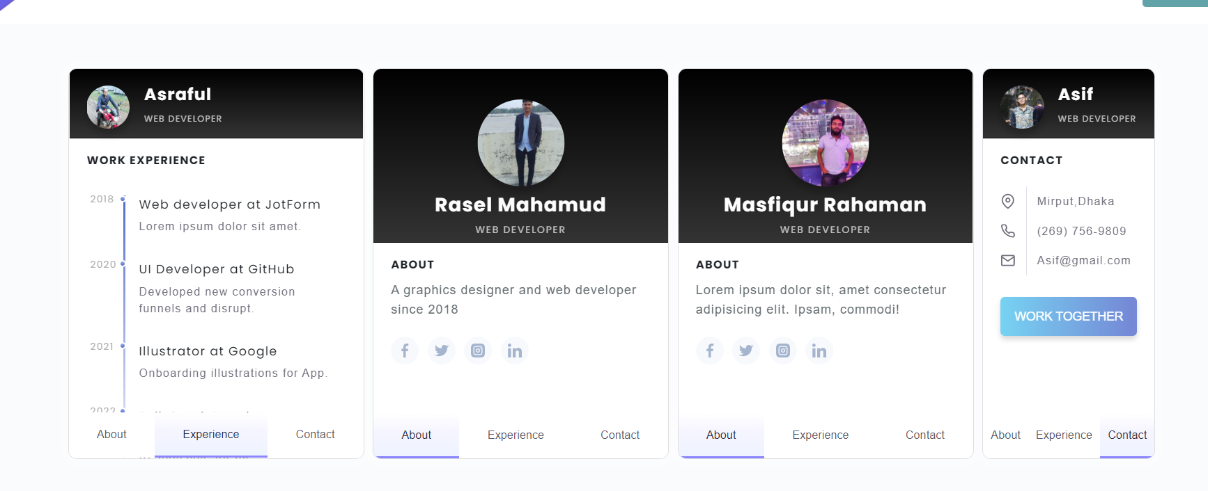
TEAM

Slide 33
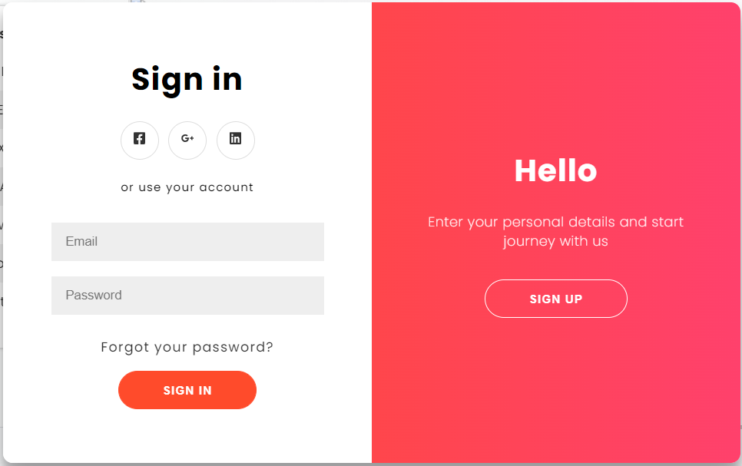
LOGIN(USER)

Slide 34
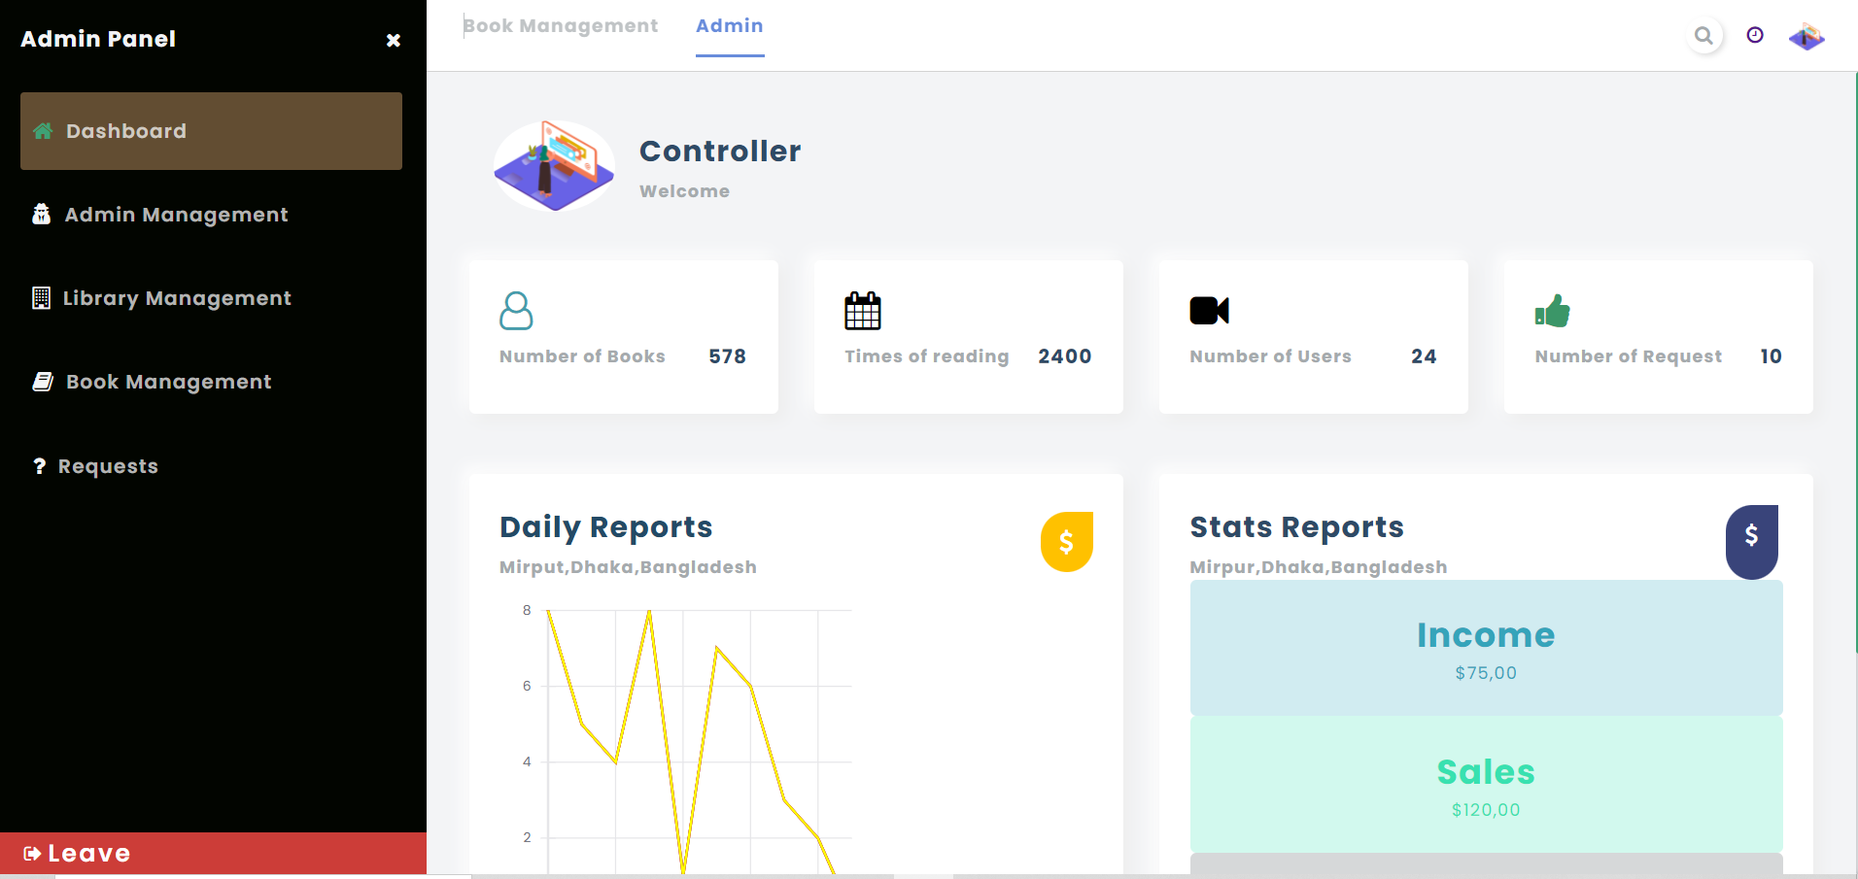
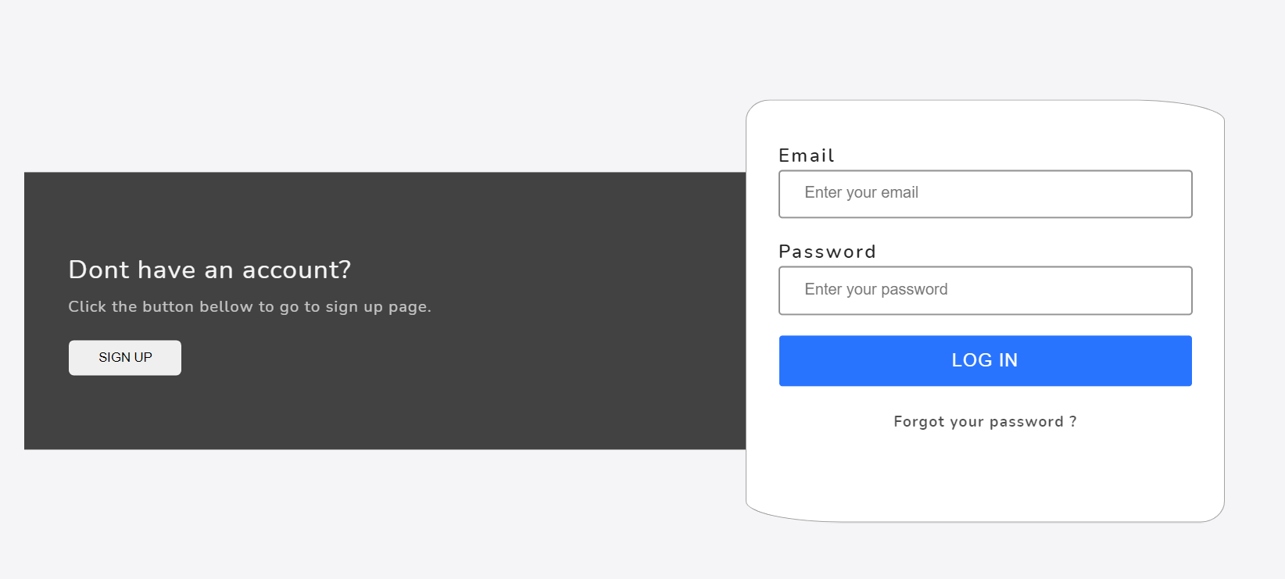
LOGIN (ADMIN)

Slide 35
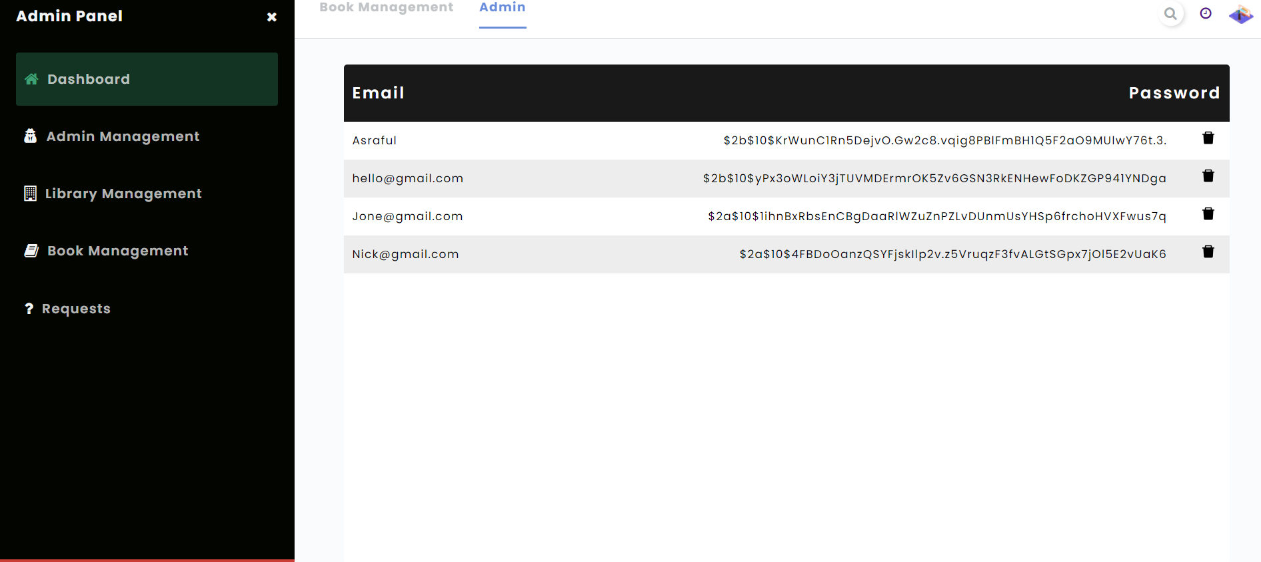
ADMIN MANAGEMENT

Slide 36
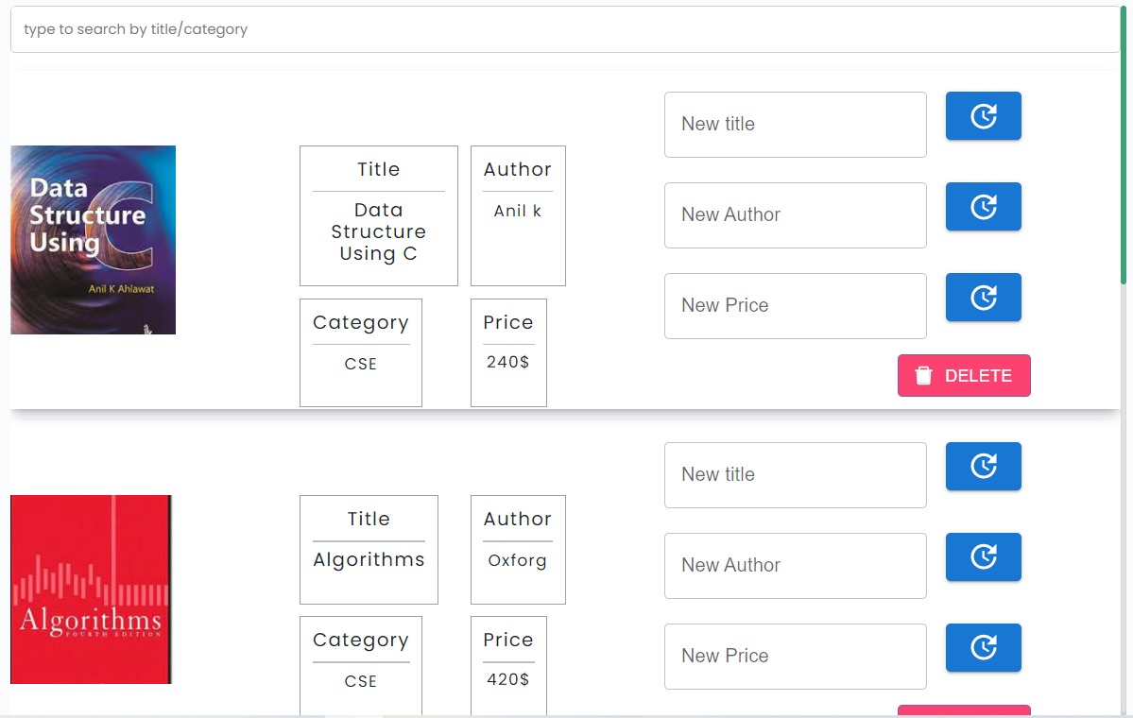
LIBRARY MANAGEMENT

Slide 37
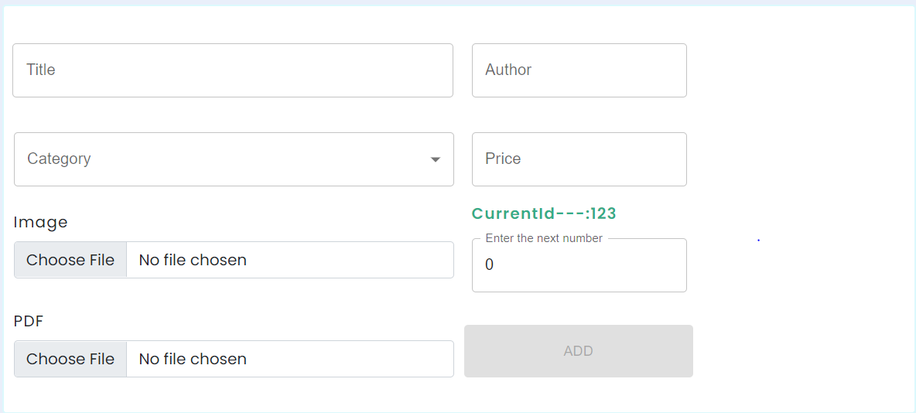
BOOK MANAGEMENT

Slide 38
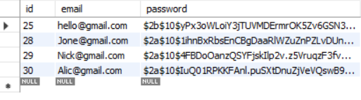
AUTHENTICATION

Slide 39
BENEFITS

Slide 40
BENEFITS
This system is user friendly
Accessible at any location
More reach to user
Easy to find books
Saves time and money
Search for books made easy
Easy and manageable admin panel

Slide 41
LIMITATION

Slide 42
LIMITATION
Payments system
Don’t have Google maps feature
Cant view PDF before download
Not usable without the internet

Slide 43
CONCLUTION

Slide 44
CONCLUTION
Digital Library allows the user to store the book detailes and the person details.
This software allows storing the details of all the data related to library
The implementation of the system will reduce data entry time and provide readily calculated reports.

Slide 45
THANK YOU

